Slide 1
Week 3 Class 1:
Assessing social media misuse
INST408C: Cognitive Security | Fall 2021 | SJ Terp

Slide 2
Environment

Slide 3
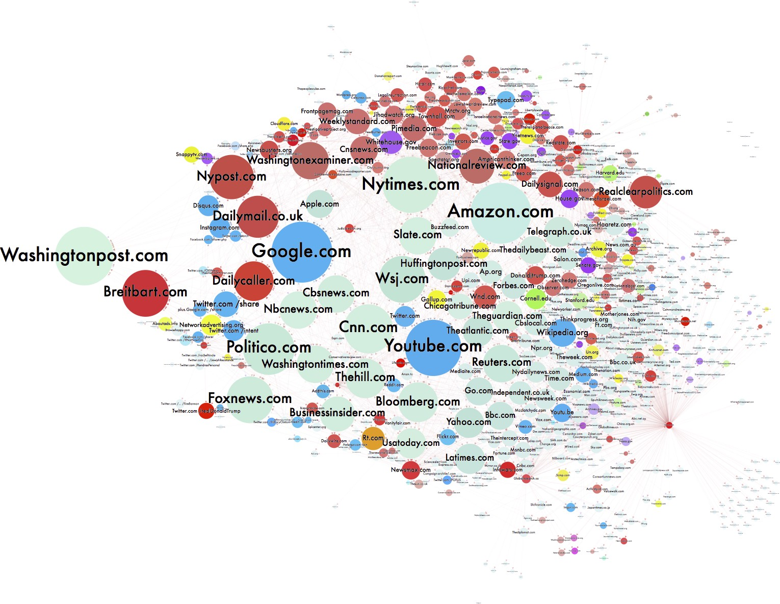
Channels
Lots of channels:
Where people seek, share, post information
Where people are encouraged to go
Image: https://d1gi.medium.com/the-election2016-micro-propaganda-machine-383449cc1fba
Notes:
IMage: https://d1gi.medium.com/the-election2016-micro-propaganda-machine-383449cc1fba

Slide 4
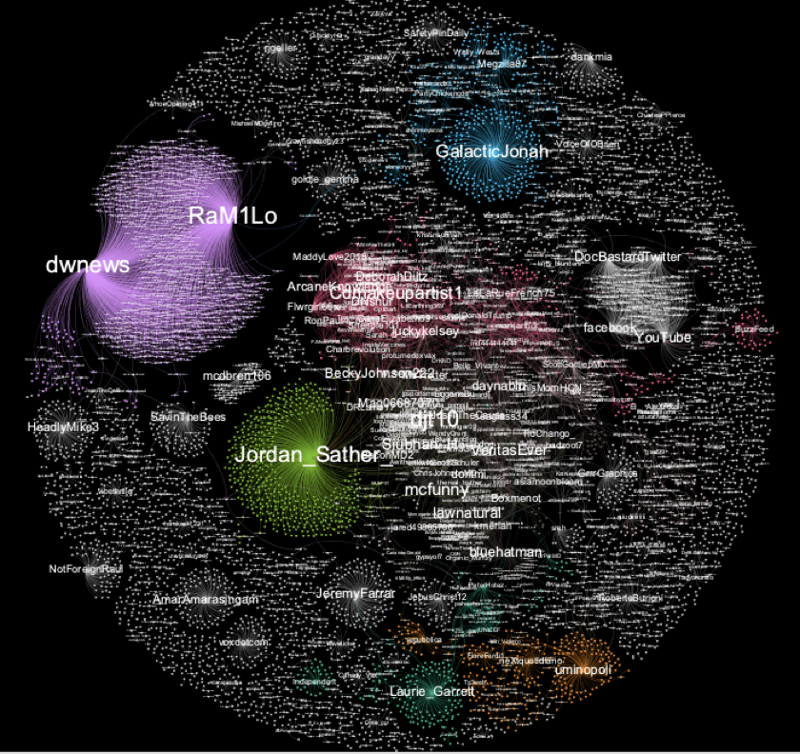
Influencers
Users or accounts with influence over a network
Not the most followers
The most influence
Might be large influence over smaller groups.

Slide 5
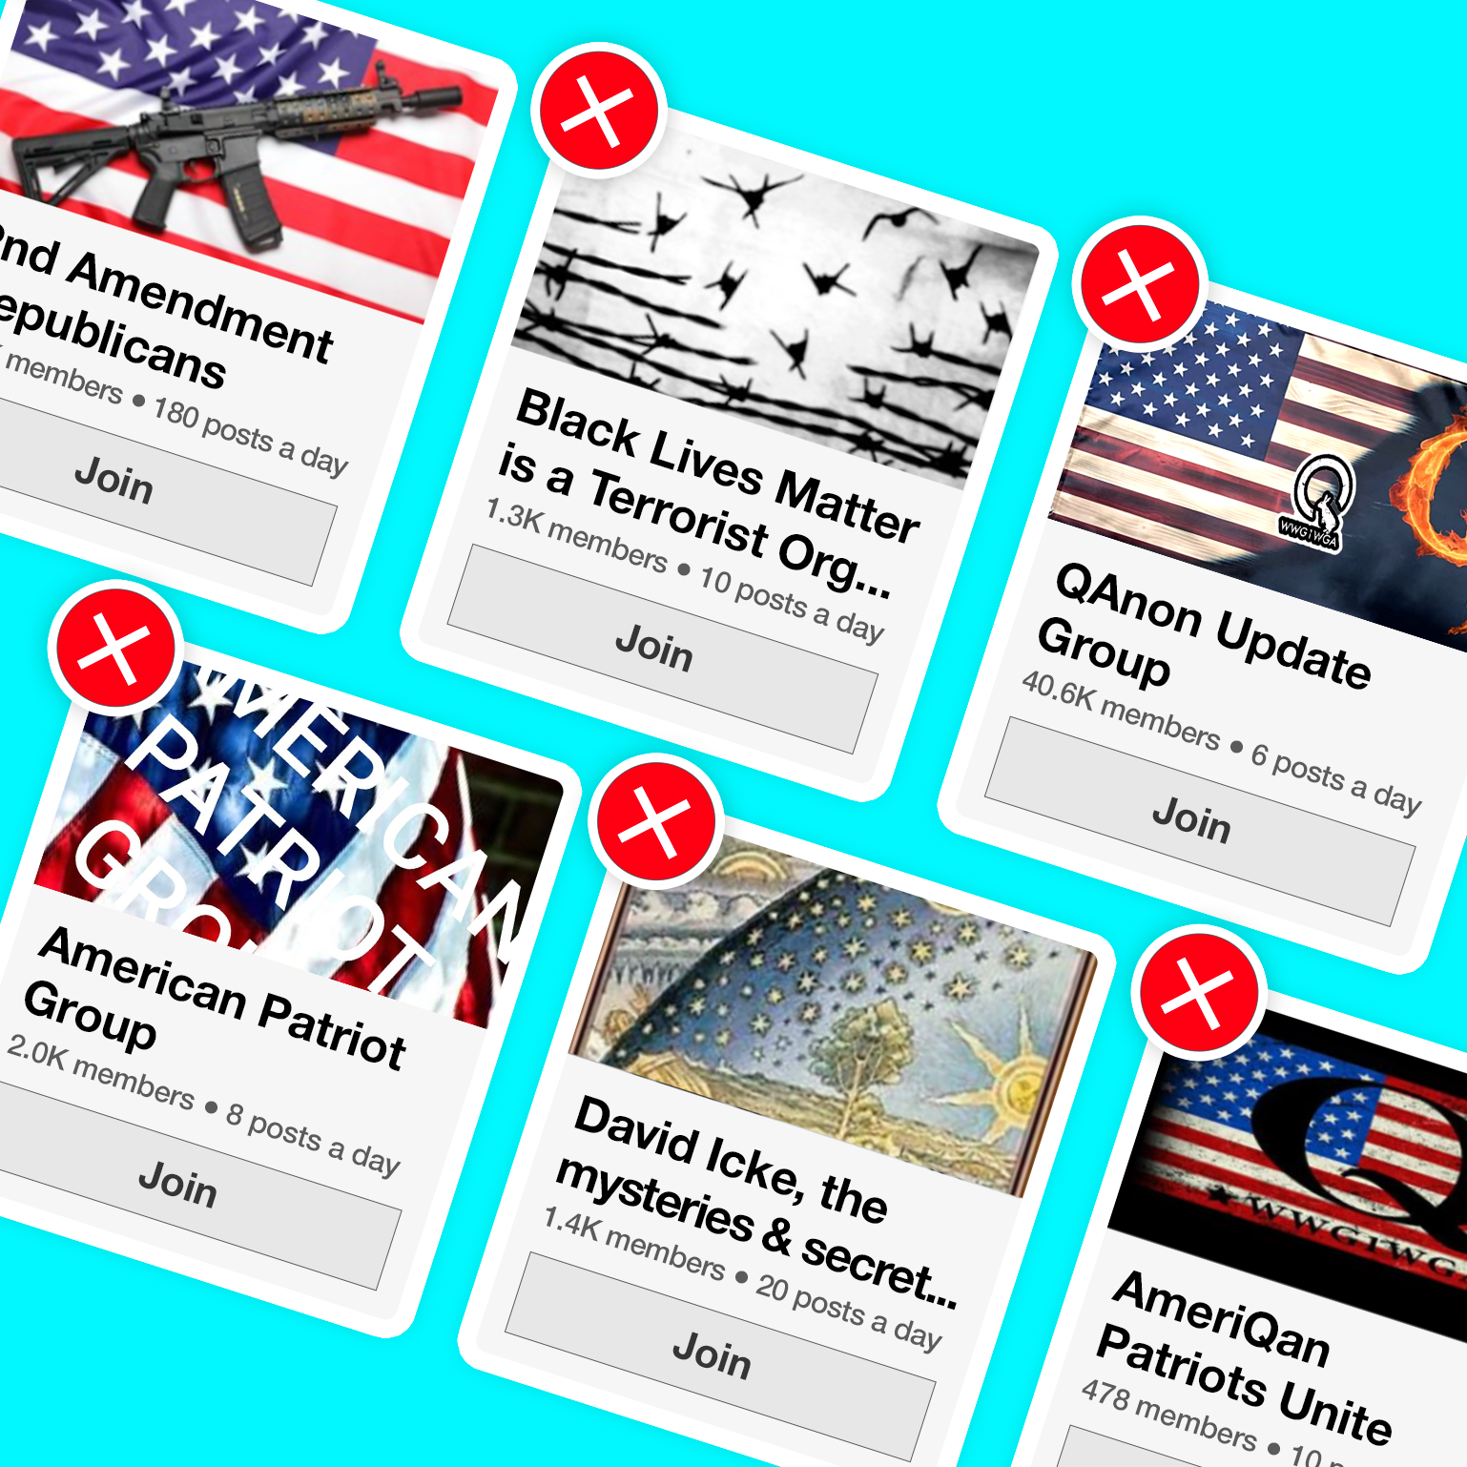
Groups
Social media groups created to create or spread disinformation
Often real members, fake creators
Lots of themes
Often closed groups
Notes:
Image: https://accountabletech.org/campaign/stop-group-recs/

Slide 6
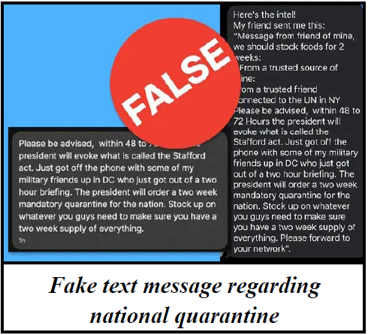
Messaging
Narratives designed to spread fast and be “sticky”
Often on a theme
Often repeated
Image: https://www.njhomelandsecurity.gov/analysis/false-text-messages-part-of-larger-covid-19-disinformation-campaign
Notes:
Image: https://www.njhomelandsecurity.gov/analysis/false-text-messages-part-of-larger-covid-19-disinformation-campaign

Slide 7
Objects

Slide 8
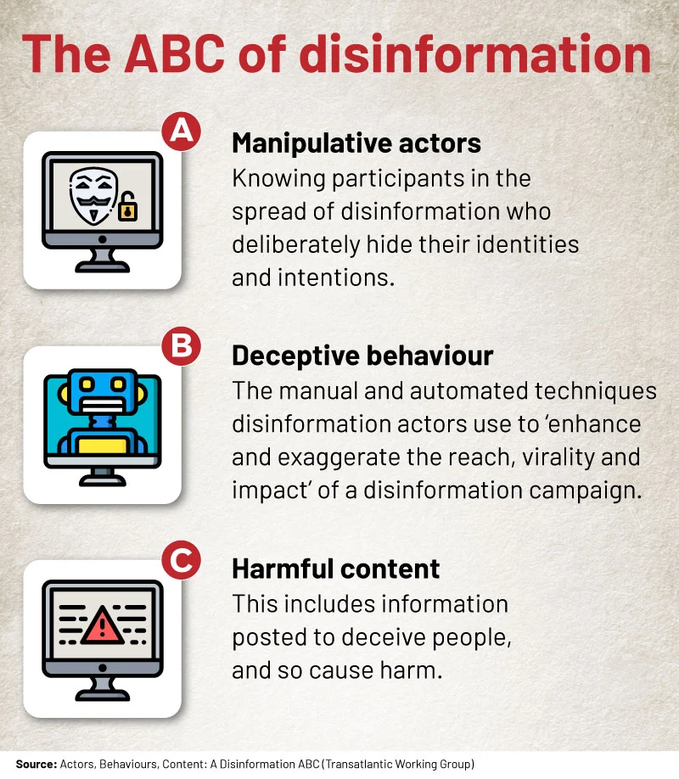
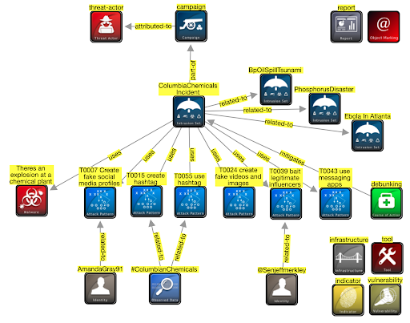
ABC model, STIX model
Notes:
ABC from https://africacheck.org/fact-checks/reports/anatomy-disinformation-campaign-who-what-and-why-deliberate-falsehoods-twitter

Slide 9
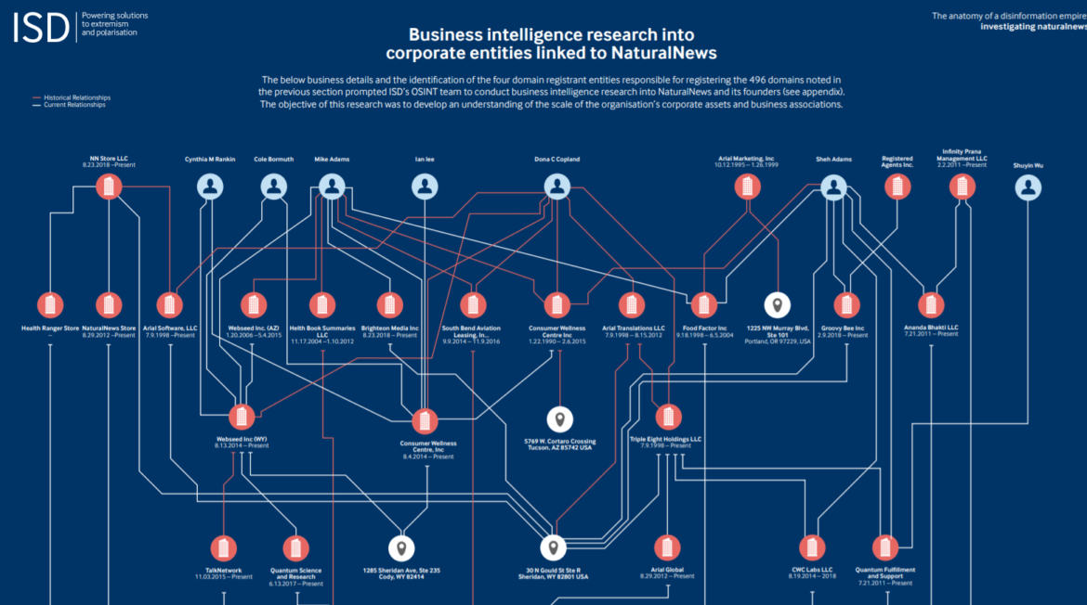
Actors
Entities behind disinformation
Nationstates
Individuals
Companies
Entities part of disinformation
DAAS companies
Image: https://gijn.org/2020/07/08/6-tools-and-6-techniques-reporters-can-use-to-unmask-the-actors-behind-covid-19-disinformation/

Slide 10
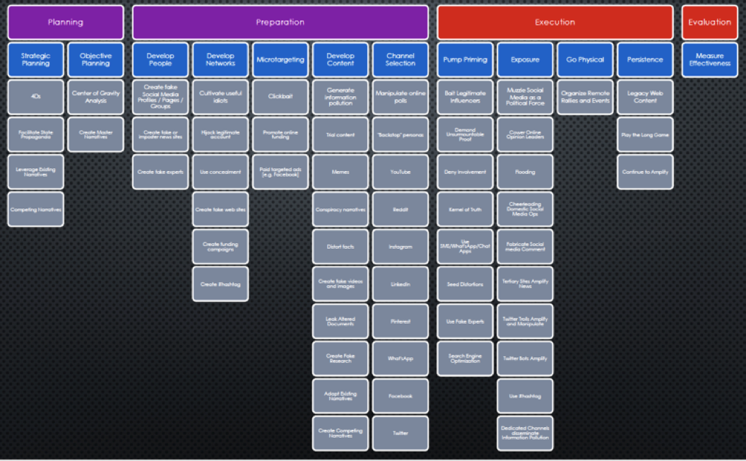
Behaviours
Techniques used in misinformation or disinformation campaigns
Useful to track because they’re often repeated, and we can design mitigations and countermeasures

Slide 11
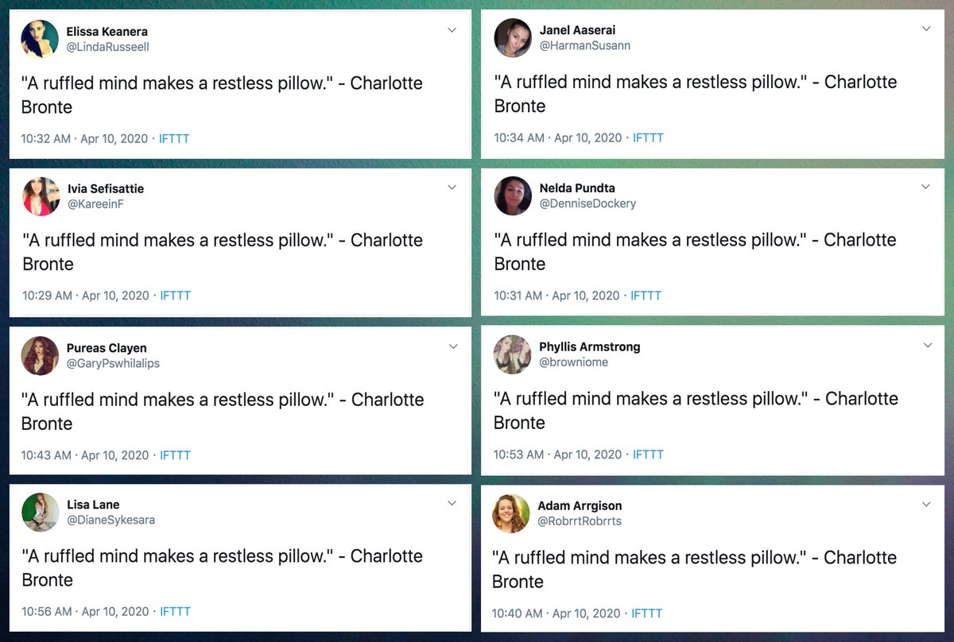
Tools
Bots
IFTTT variants
Personas
Network analysis
Marketing tools
Image: https://twitter.com/conspirator0/status/1249020176382779392

Slide 12
Disinformation pyramid

Slide 13
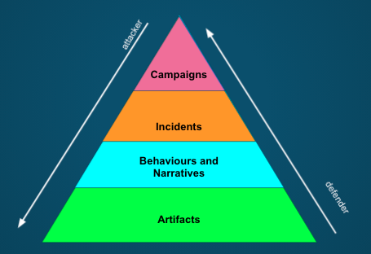
Disinformation Pyramid

Slide 14
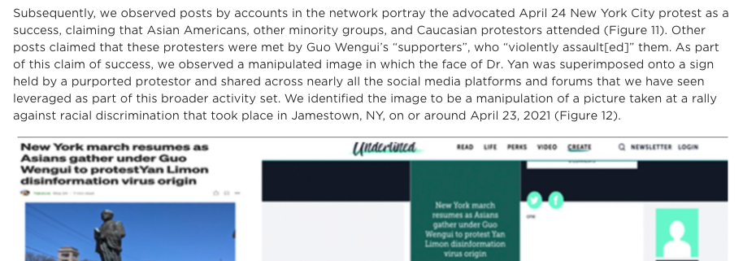
Incidents
Time-limited events (typically 2-3 days)
Areas include:
Elections
Disasters
Other events (e.g. Covid19)
Geopolitical support (e.g. Crimea)
Notes:
https://www.fireeye.com/blog/threat-research/2021/09/pro-prc-influence-campaign-social-media-websites-forums.html

Slide 15
Campaigns
Advanced Persistent Manipulators: “with resources, talent, and technology for advancing their influence over an enduring period” (Clint Watts)
Gen 1: disrupt the system: hacktivists
Hacking to shape public opinion
Gen 2: exploit the system: extremists (ISIS)
Social media influence
Gen 3: distort the system (Russia)
Social media influence fusion centre (personas, news sites, include in-person influence),
Gen 4: dominate the system (trolling as a service)
AI, social bots, false content, in-person, apps
Gen 5: Own the system (China, corporations)
Internet balkanisation to apps, create preferred reality
Notes:
https://www.fpri.org/article/2019/03/five-generations-of-online-manipulation-the-evolution-of-advanced-persistent-manipulators/

Slide 16
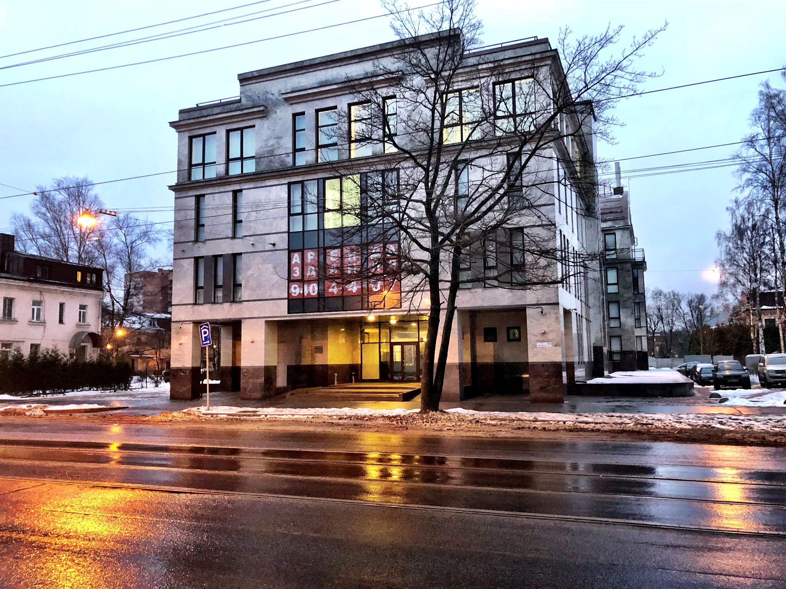
Internet Research Agency
Russian “troll farm”
Well organised
Ex marketing
Not quite official

Slide 17
Narratives
Covid isn’t serious
Covid doesn’t exist
Individual medical targets
Medical scams
MMS prevents
Alcohol prevents
etc
Origin myths
Escaped bioweapon
Country x created Covid
US soldiers took Covid to China
Resolution myths
Country y has a Covid cure
Crossover with conspiracies
Covid and 5G
Covid and antivax / anti-Gates
Helicopters spraying for covid
Depopulation conspiracy
Crossover with ‘freedom rights’
Anti- stayathome
2nd amendment
anti-immigration
Usual far-rightwing groups
Geopolitics
China, Iran: covert + overt
“Blue check” disinfo

Slide 18
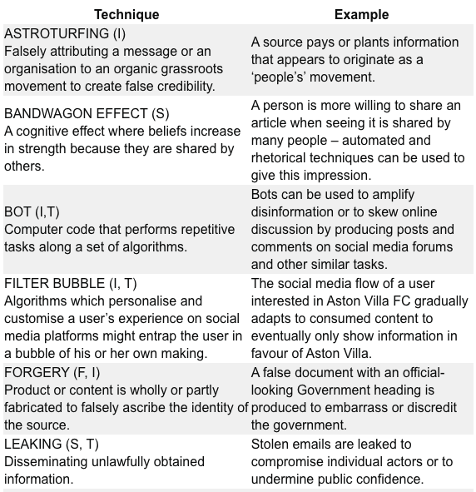
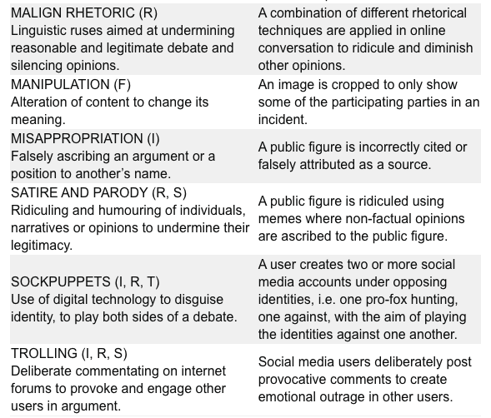
Behaviours (RESIST toolkit)
Notes:
https://gcs.civilservice.gov.uk/publications/resist-counter-disinformation-toolkit/

Slide 19
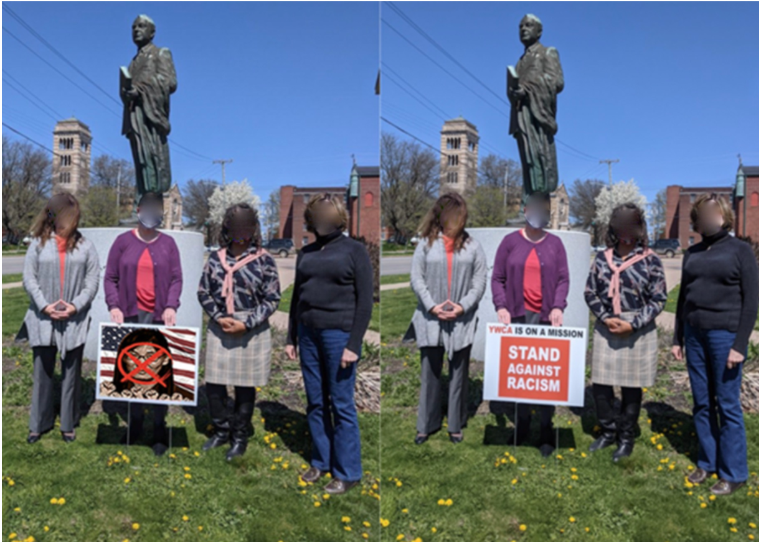
Artifacts
Text, images, videos, audio etc
Accounts, groups
Connections between them
Image: https://www.fireeye.com/blog/threat-research/2021/09/pro-prc-influence-campaign-social-media-websites-forums.html

